Slide 1
IBM Crop Recommendation with web application Project Submission
“Exploring the Power of Agentic AI with IBM Granite and LangFlow”

Slide 2

Project Tile – Crop recommendation Agent
Domain of Project – Agriculture
Student Name | Recent Passport Photo | Email ID | Mobile number [WhatsApp]
PAVITHRA S |  | 720823108029@hit.edu.in

Slide 3
Problem Statement -
Problem Statement: Crop Recommendation Agent
The Challenge
Farmers often struggle to decide which crops to grow due to varying soil conditions, unpredictable weather, water availability, and fluctuating market demand. Information about soil health, climate patterns, crop suitability, and best agricultural practices is scattered across unreliable or outdated sources. Without personalized, real-time guidance, many farmers face poor yields, resource wastage, and reduced profitability.
The Objective
Build an AI-powered Crop Recommendation Agent that delivers personalized farming insights and guidance for farmers, agricultural cooperatives, and agronomists. The solution should:
Personalized Crop Plans – Recommend crops based on soil type, pH, nutrient levels (N, P, K), rainfall, temperature, season, and land size.
Soil & Climate Data RAG Retrieval – Fetch and summarize soil composition, weather forecasts, and market price data from reliable agricultural sources.
Field Monitoring & Feedback – Allow farmers to log field conditions via text, images (soil/crop photos), or voice, and provide instant analysis on crop health and growth stage.
Preventive Farming Focus – Suggest crop rotation plans, pest/disease management, and sustainable farming practices to protect long-term soil health.
Multi-Agent System –
Soil & Climate Knowledge Agent (fetches soil, weather, and market data)
Crop Recommendation Agent (personalized crop suggestions based on land and conditions)
Farming Advisory Agent (preventive pest, disease, and sustainability suggestions)
Field Log & Feedback Agent (crop/field tracking and yield analysis)
Visualization Dashboard – Show soil health trends, predicted yield, seasonal crop performance, and progress toward sustainable farming goals.

Slide 4
Technology Used
Tech Stack (Mandatory)
Use any one of the following approaches:
LangFlow + IBM watsonx.ai + Granite Models
IBM Cloud Agentic Lab with IBM Granite Models
Replicate with LangChain + RAG + IBM Granite Models
I used LangFlow + IBM watsonx.ai + Granite Models

Slide 5
Proposed Solution -
The proposed solution is a multi-agent AI-powered Crop Recommendation Agent built using LangFlow, IBM watsonx.ai, and Granite Models to provide personalized, real-time agricultural guidance. The system addresses challenges in crop selection, soil management, and preventive farming through an intelligent, modular architecture.
At its core, the solution uses a Retrieval-Augmented Generation (RAG) pipeline to fetch accurate agricultural data from trusted sources such as government agricultural databases, soil health surveys, and weather/climate datasets. This data is embedded and stored in a vector database, enabling the system to retrieve and summarize soil composition, climate patterns, and crop suitability details using Granite models.
The system consists of four key agents:
Soil & Climate Knowledge Agent retrieves and summarizes soil, weather, and market data using RAG.
Crop Recommendation Agent generates personalized crop suggestions based on user inputs such as soil type, pH, nutrient levels (N, P, K), rainfall, temperature, and land size.
Farming Advisory Agent provides preventive farming suggestions, including crop rotation plans, pest/disease management, and sustainable soil practices.
Field Log & Feedback Agent allows farmers to log field conditions via text, voice, or images and delivers instant analysis with actionable feedback on crop health and growth.
The solution includes a user-friendly dashboard (built with Streamlit or React) that visualizes soil health trends, predicted yields, seasonal crop performance, and progress toward sustainable farming goals.
LangFlow is used to orchestrate agent workflows, while watsonx.ai ensures scalable model deployment, embeddings, and AI governance. Granite models power reasoning, summarization, and personalization.

Slide 6
Langflow component Used -
Chat Input – Interface where users (farmers) enter their queries, soil details, or field conditions (text/voice/image).
IBM watsonx AI Agent – Processes user input using Granite models to generate personalized crop recommendations and farming insights.
Name of IBM Granite model – Granite-4.0-8B-Instruct → Fast, efficient for real-time crop recommendations.
Chat Output – Displays AI-generated responses such as recommended crops, soil health analysis, and farming suggestions.
File Component – Stores and retrieves user data, field logs, soil reports, and crop datasets for analysis and tracking.
Additional Component – Weather API Integration – Fetches real-time and forecasted climate data (rainfall, temperature, humidity) to refine crop suitability recommendations.

Slide 7
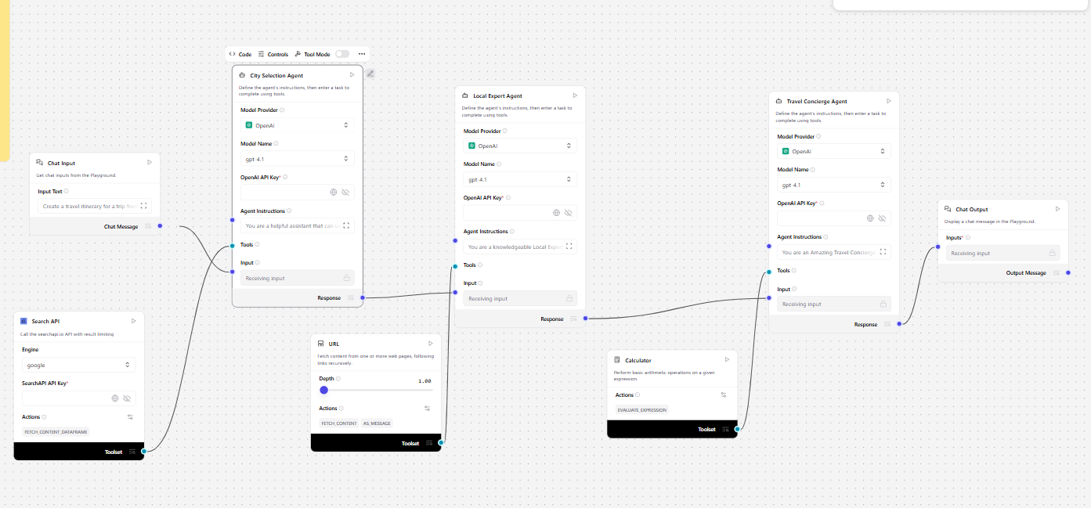
Langflow workflow -

Slide 8

Architecture blueprint

Slide 9

Role of Agentic AI in the solution
Agentic AI enables the Crop Recommendation Agent to function as an intelligent, autonomous system rather than a simple chatbot. Using IBM watsonx.ai and IBM Granite models, it coordinates multiple specialized agents to deliver personalized farming guidance.
Each agent performs a specific role—such as retrieving soil and climate data, generating crop recommendations, providing farming advisory, and analyzing field logs—while working collaboratively. This multi-agent approach ensures efficient task execution and accurate results.
Agentic AI also brings context awareness, understanding field details like soil type, location, season, and water availability to generate tailored recommendations. It supports real-time adaptation, continuously updating suggestions based on user inputs like field conditions and weather changes.
Additionally, agents communicate with each other, enabling better decision-making and improved outcomes.

Slide 10
Token Usage
11,761 token are used
·
·
·

Slide 11
Novelty and Uniqueness
Agentic AI enables the Crop Recommendation Agent to function as an intelligent, autonomous system rather than a simple chatbot. Using IBM watsonx.ai and IBM Granite models, it coordinates multiple specialized agents to deliver personalized farming guidance.
Each agent performs a specific role—such as retrieving soil and climate data, generating crop recommendations, providing farming advisory, and analyzing field logs—while working collaboratively. This multi-agent approach ensures efficient task execution and accurate results.
Agentic AI also brings context awareness, understanding field details like soil type, location, season, and water availability to generate tailored recommendations. It supports real-time adaptation, continuously updating suggestions based on user inputs like field conditions and weather changes.
Additionally, agents communicate with each other, enabling better decision-making and improved outcomes.
Overall, Agentic AI makes the system proactive, personalized, and goal-driven, acting like a smart digital agronomist that helps farmers maximize yield and maintain sustainable farming practices.

Slide 12
Git Hub Link
NAME : PAVITHRA S
LINK: https://github.com/pavithra-576/Crop-recommendation-with-web-application
·
·
·

Slide 13
Future Scope
1.Integration with IoT & Field Sensors – The system can be integrated with soil sensors, drones, and weather stations to collect real-time data such as soil moisture, temperature, humidity, and nutrient levels. This will enable the Crop Recommendation Agent to provide more accurate and dynamic farming recommendations based on actual field conditions.
2.AI-Powered Voice Assistant & Multilingual Support – Enhancing the system with a voice-enabled assistant and support for multiple regional languages will improve accessibility. Farmers can interact naturally in their preferred language, making the solution more inclusive and suitable for diverse rural populations with varied linguistic backgrounds.
·
·
·

Slide 14


